Slide 1
Genodermatosis

Slide 2
Neurofibromatosis
NF is an autosomal dominant disorder that affects the bone, the nervous system, soft tissue, and the skin.

Slide 3
Clinical features
1- Café au lait spots . brown macules. develop during the first 3 years of life . 5 or more greater than 0.5 cm in diameter are suggestive of NF.
2-Lisch nodules are pigmented hamartomas of the iris
3-Axillary freckling diagnostic feature in NF
4-Neurofibromas benign tumor of NF.They can develop along a nerve.
Bone involvement : kyphoscoliosis, pseudoarthrosis
neurologic abnormalities deafness , seizures
Endocrinologic problems . Short stature and growth hormone deficiency

Slide 4
Tuberous Sclerosis
autosomal dominant
epilepsy, mental retardation, and adenoma sebaceum

Slide 5
Skin findings
1- adenoma sebaceum, is cutaneous hamartoma .(angiofibroma),clusters of yellowish-pink papules,located mainly on nasolabial fold,cheek & chin
2- hypomelanotic (ash leaf) macules :earliest sign,present at birth
3– Shagreen patch . soft, ﬂesh-colored to yellow plaques with an irregular surface ,appears most commonly in the lumbosacral region.
4-Periungual fibroma : appear at or after puberty in approximately 50% of cases. They are
smooth, ﬂesh-colored, conical projections that emerge
from the nailfolds of the toenails and ﬁngernails

Slide 7
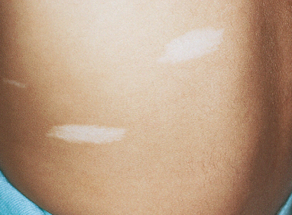
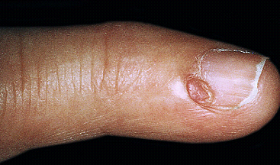

Slide 8
Xeroderma Pigmentosum (XP)
Autosomal recessive
Defective DNA excision repair mechanism after exposure to UV light, sever photosensitivity, freckling & skin cancers before the age of 10 years.
Ocular abnormalities included ectropion,photophobia, corneal opacity.
Progressive neurological degeneration
hearing loss, spasticity, ataxia, polyneuropathy, mental retardation

Slide 10
Ichthyosis
group of skin disorders characterized
by an excess accumulation of cutaneous scale,
Ichtyosis either congenital or acquired.
congenital:
1-Dominant ichthyosis vulgaris (DIV)
2-X-linked recessive ichthyosis (XLI)
3-Lamellar ichthyosis (LI)
4-Epidermolytic hyperkeratosis (EH)

Slide 11
Ichthyosis vulgaris
Most common, auto. Dominant, onset usually at puberty, excessive dryness (xerosis) & scales on trunk & limbs but sparing the flexures, no significant ocular findings, The condition tends to improve with age ,frequently associated with atopy,

Slide 12
Acquired ichthyosis
usually in adults as small, white, fine scales that seen mainly on the extremities
1- internal neoplasia (eg, Hodgkin lymphoma, leukemia),
2-systemic illness: sarcoidosis, hypothyroidism, chronic hepatitis, malabsorption , bone marrow transplantation,
3- infection: HIV, leprosy
4- drugs: nicotinic acid, statins,

Slide 13
